Slide 1

Instrumentation and Control
CSE 325
Md Atikul Islam
Lecturer(EEE)
Computer Science and Engineering(CSE)
Daffodil International University(DIU)

Slide 2
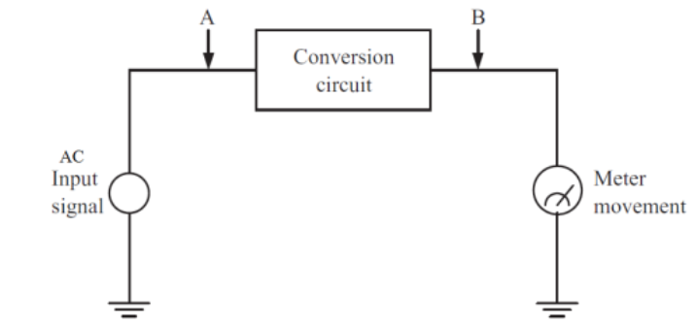
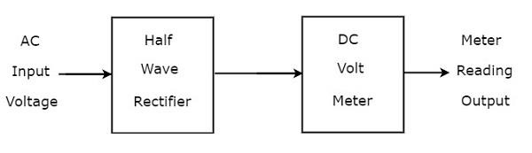
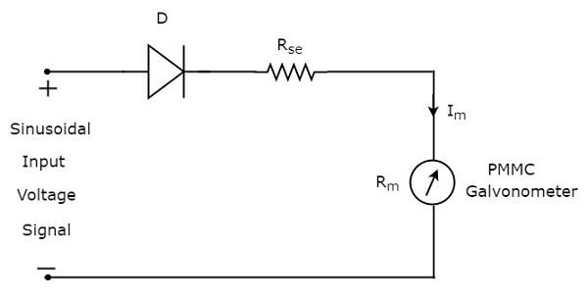
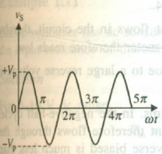
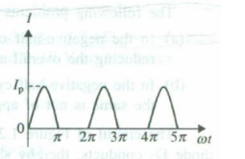
Rectifier-based AC Meters
Half-wave rectifier AC Meter:

Slide 3
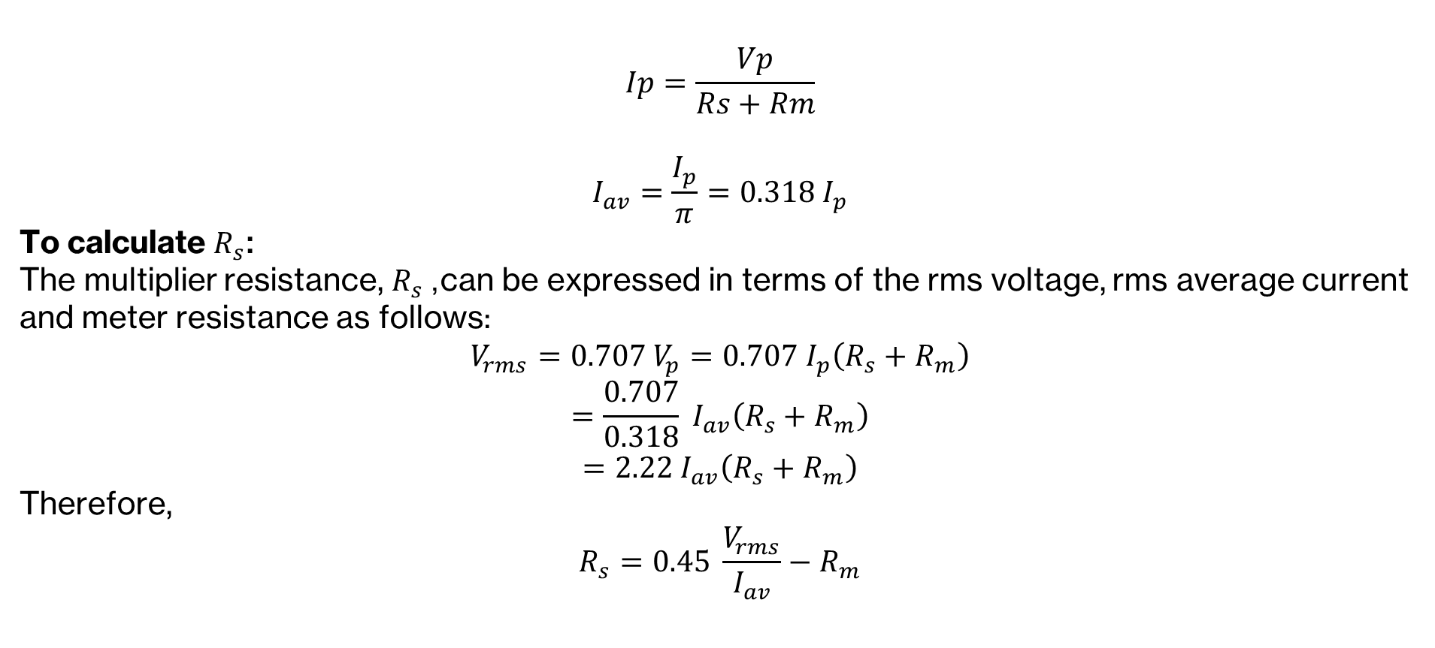
Rectifier-based AC Meters

Slide 4
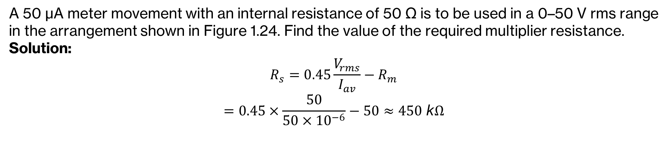
Rectifier-based AC Meters

Slide 5
Rectifier-based AC Meters
Half-wave rectifier AC Meter:
Disadvantages:
1. In negative half-cycle, reverse current flows through the circuit
reduces average value of current
meter reads lower than actual.
2. High peak inverse voltage (PIV) rating of Diode is required

Slide 6
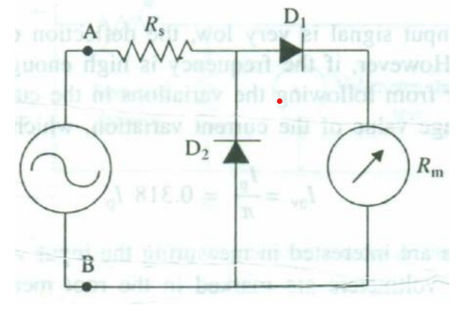
Rectifier-based AC Meters
Solution:
In negative half-cycle, D2 conducts. And so, no negative current flows through the meter movement. Because of this diode action, the circuit is protected from reverse current, and the meter only sees the positive portion of the waveform.
PIV rating requirement is much less than the large peak input voltage(Vp).

Slide 7
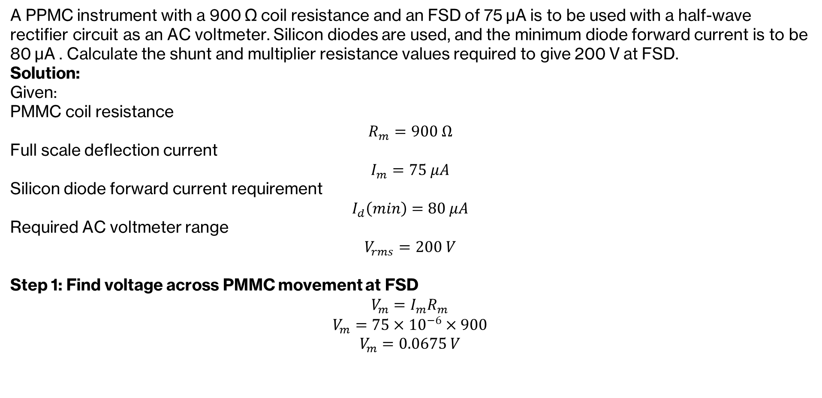
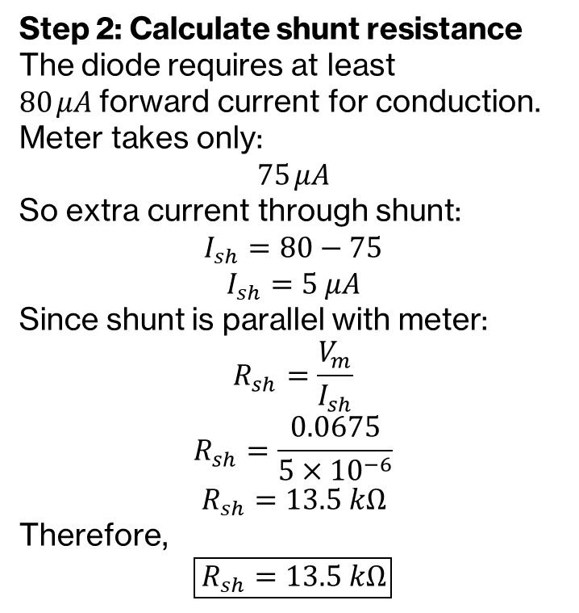
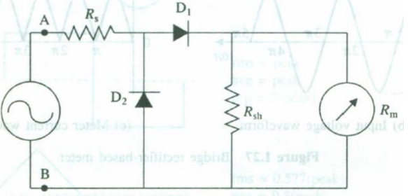
Rectifier-based AC Meters
Full-Scale Deflection(FSD)

Slide 8
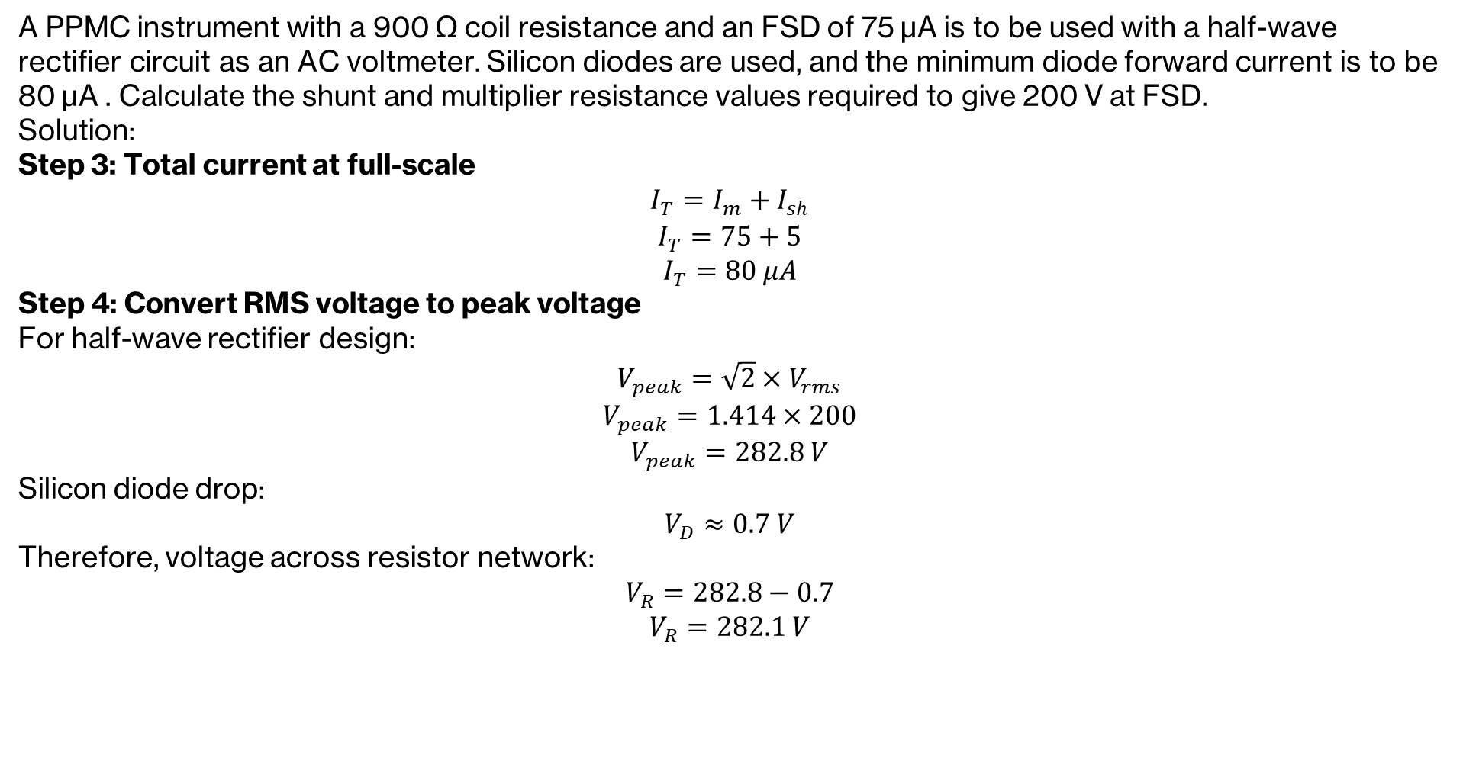
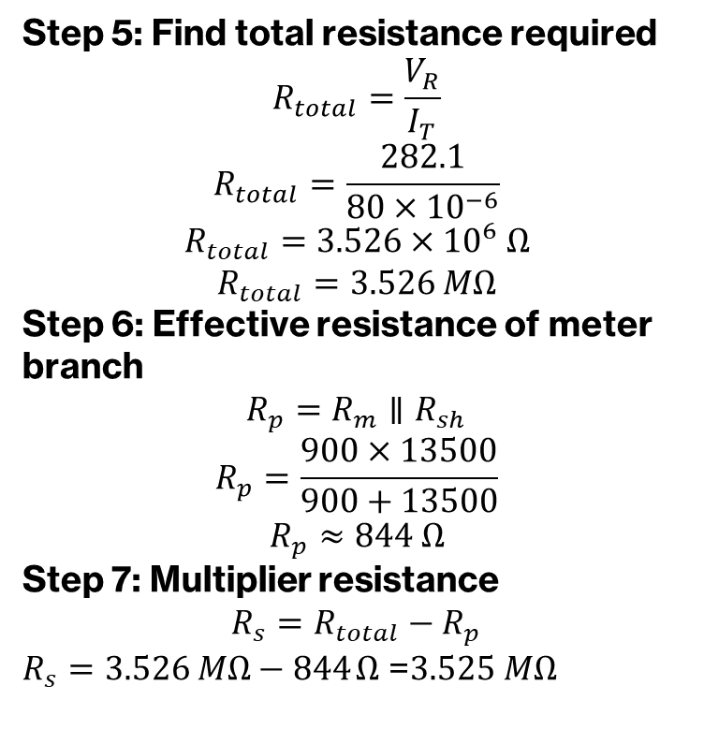
Rectifier-based AC Meters

Slide 9
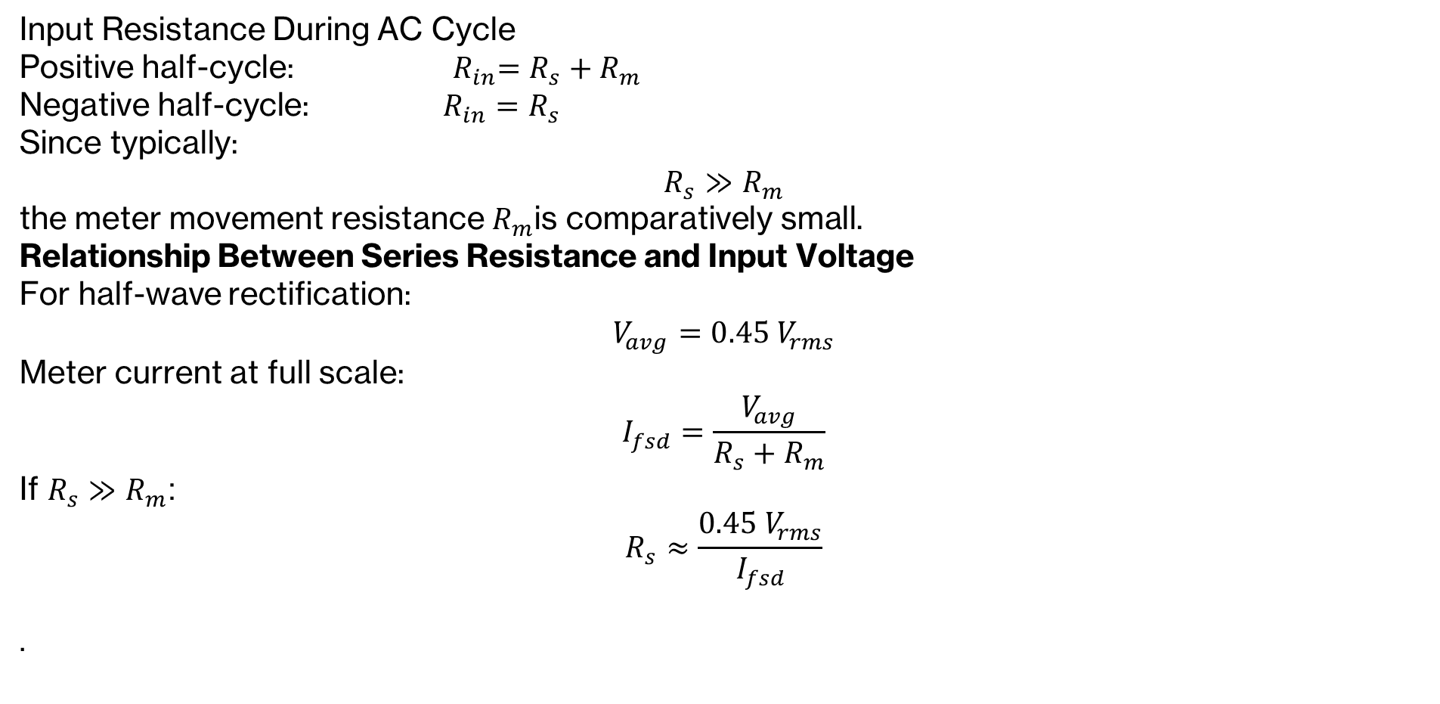
Half-Wave AC Voltmeter Sensitivity

Slide 10
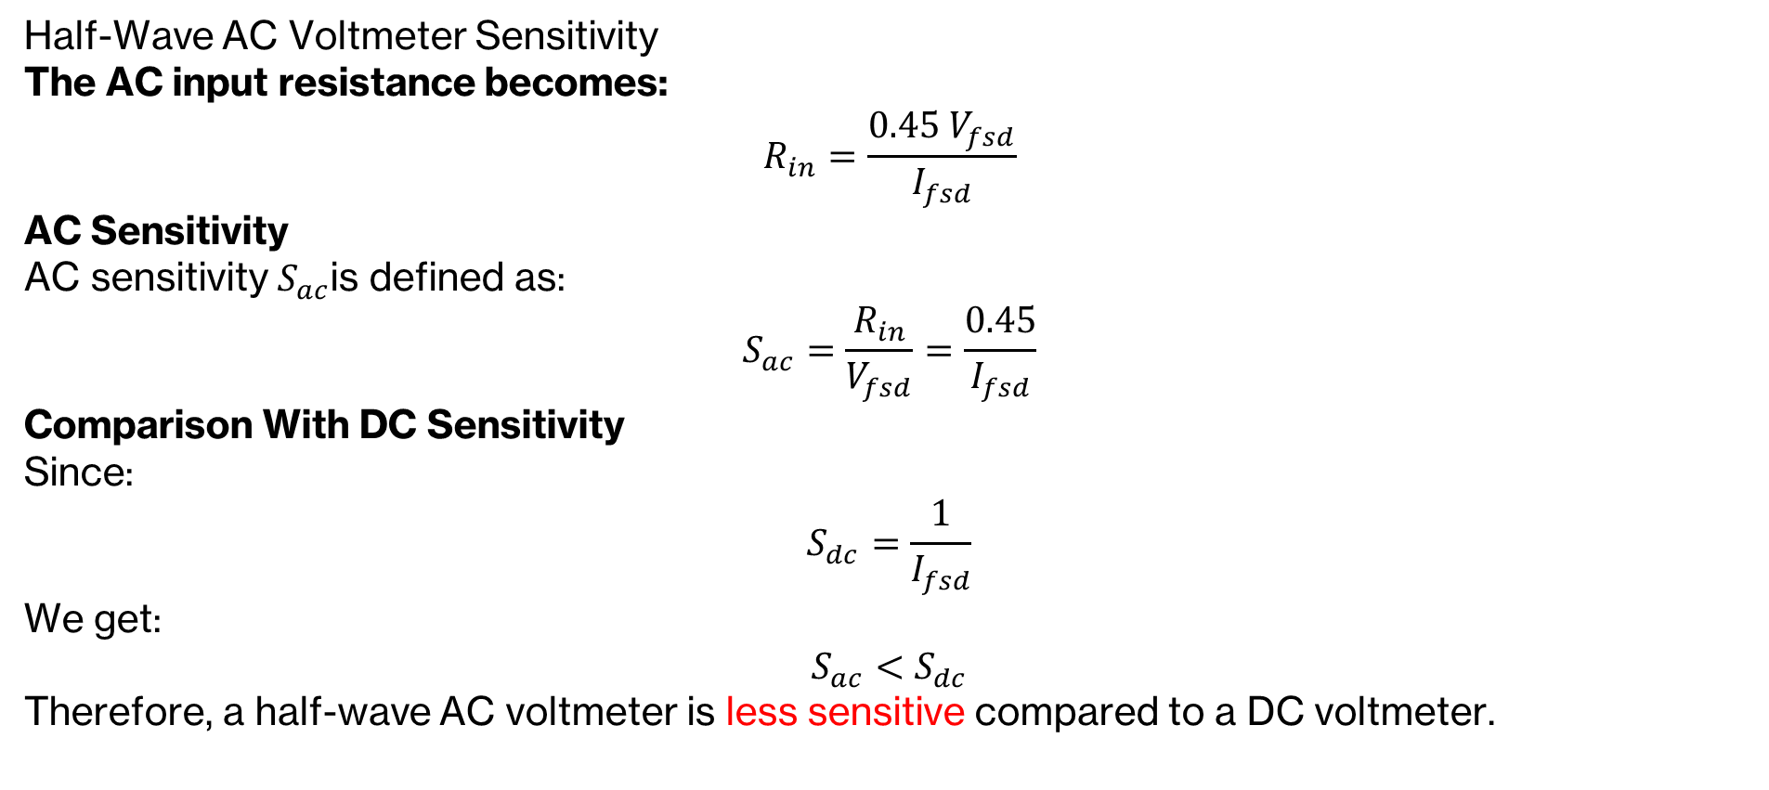
Half-Wave AC Voltmeter Sensitivity

Slide 11
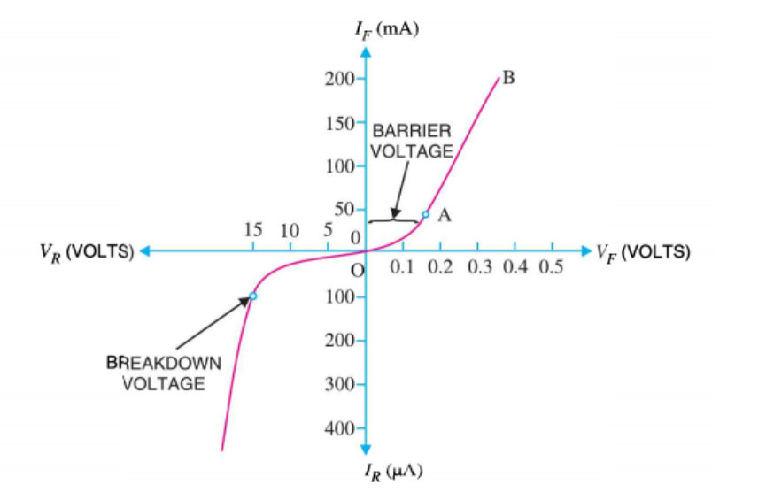
Non-linearity in Lower RMS Ranges
Diode I-V characteristics are inherently non-linear
This non-linearity is most noticeable at low currents and low RMS voltages
At small signals, the diode’s forward drop clips part of the waveform
The lower end of the scale becomes compressed and non-linear
Non-linearity can be reduced by operating the diode at higher current levels

Slide 12
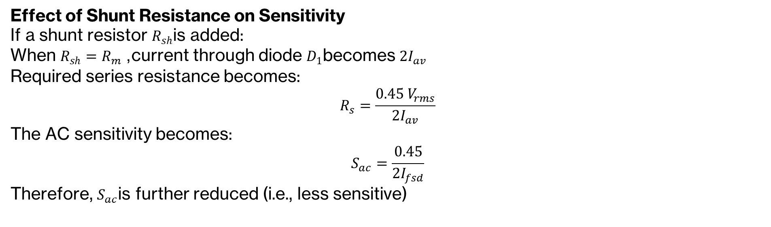
Non-linearity in Lower RMS Ranges

Slide 13
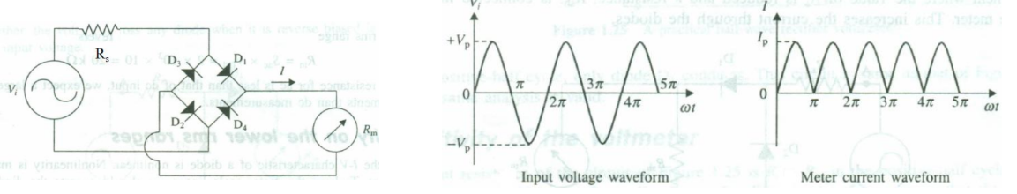
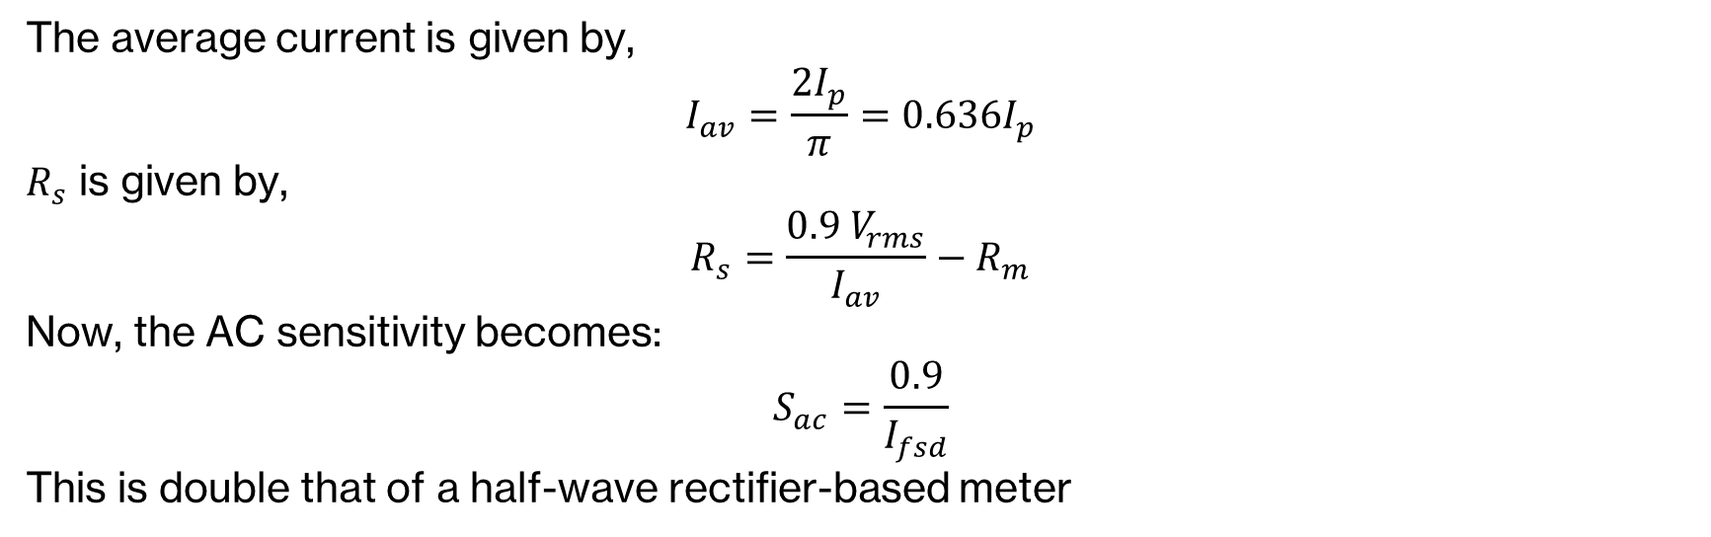
Full-wave Rectifier-based Meter

Slide 14
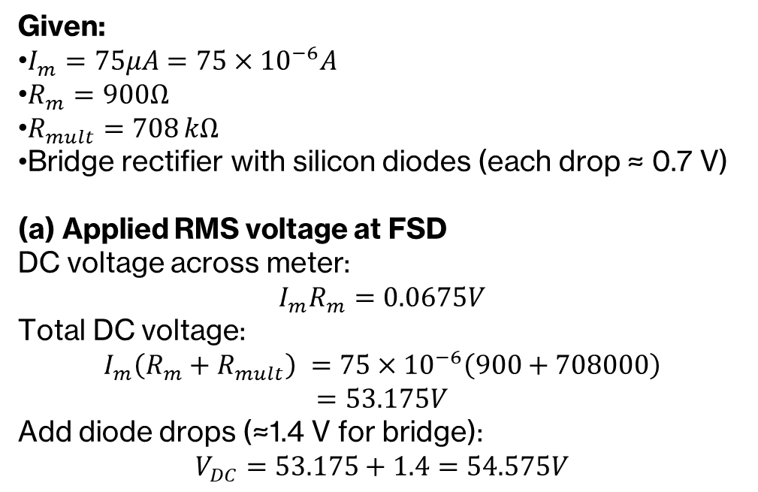
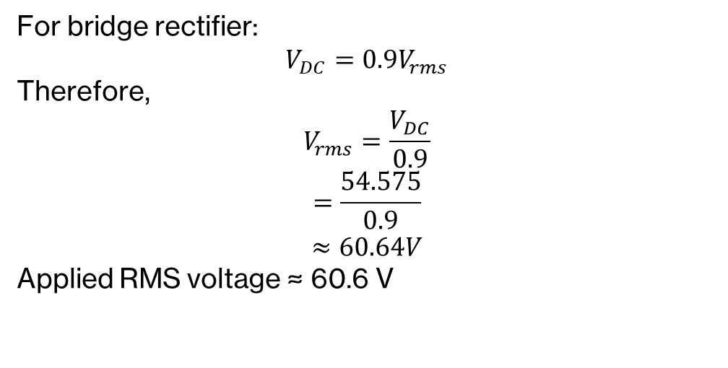
Full-wave Rectifier-based Meter
An AC voltmeter uses a bridge rectifier with silicon diodes and a PPMC instrument with FSD 75 µA. If the meter coil resistance is 900 Ω and the multiplier resistor is 708 kΩ:
(a) Calculate the applied RMS voltage when the voltmeter indicates FSD. (b) Determine the new multiplier resistance required for the voltmeter to change its range to 300 V FSD. (c) Calculate the sensitivity of the AC voltmeter.

Slide 15
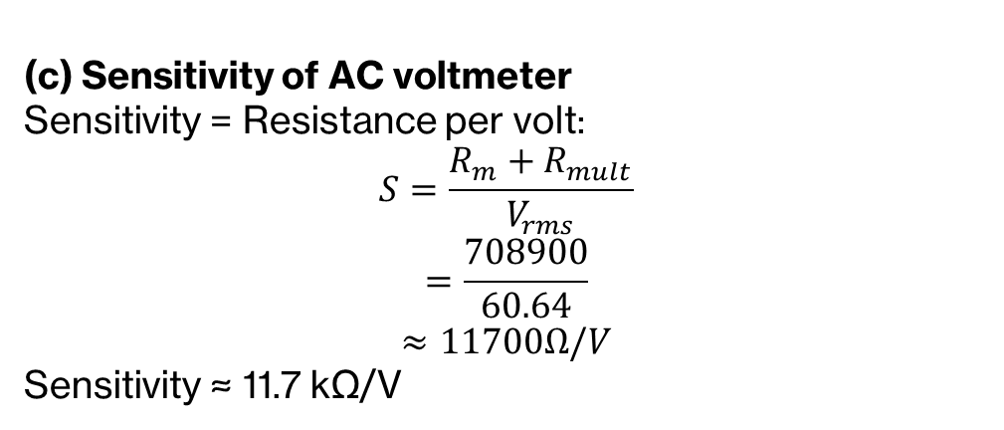
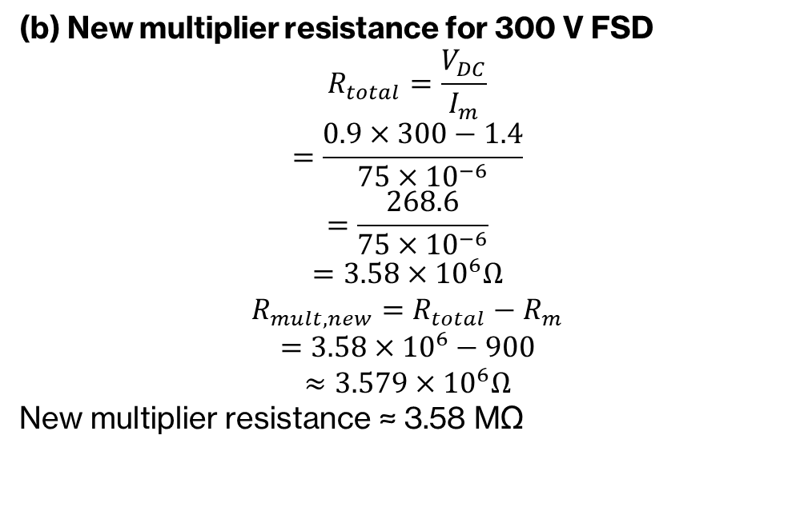
Full-wave Rectifier-based Meter
An AC voltmeter uses a bridge rectifier with silicon diodes and a PPMC instrument with FSD 75 µA. If the meter coil resistance is 900 Ω and the multiplier resistor is 708 kΩ:
(a) Calculate the applied RMS voltage when the voltmeter indicates FSD. (b) Determine the new multiplier resistance required for the voltmeter to change its range to 300 V FSD. (c) Calculate the sensitivity of the AC voltmeter.

Slide 16
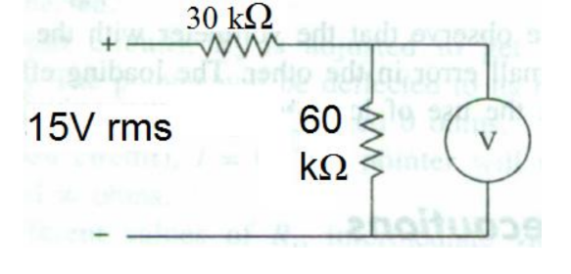

Electronic AC Ammeter
The ac voltmeter is used to measure voltage V across 60 kΩ resistor in the following circuit. What is the minimum voltage reading that should be observed?
The parameters of the ac voltmeter are:
Full-wave rectification
100 μA meter movement
15 V range
Accuracy = ± 3% fsd

Slide 17
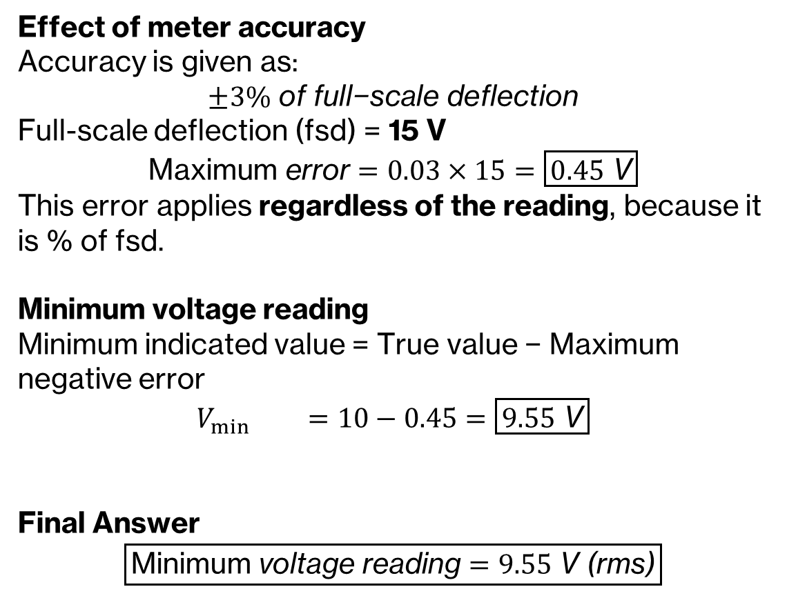
Electronic AC Ammeter

